Slide 1
Handwritten Digit Recognition
Liyan Chen lchen39@stevens.edu
Shangxing Jiang sjiang25@stevens.edu

Slide 2
INTRODUCTION
Handwritten digit recognition has been widely applied in many fields:
check verification,
postal address reading in envelop.
pin code recognition
Handwritten digit recognition is more difficult than printed digits, due to the unique writing style of different people.

Slide 3
Related work
· 2012, Niu and Suen，CNN +SVM，
recognition rate：94.40%
· 2014，Ravi and Venkateswarlu，KNN，
recognition rate：96.94%
· 2015, Eva and Nebojsa，SVM(OVO),
recognition rate： 99.05%
· 2016, Yan and JunMin,Ncfm (No combination of feature maps),
recognition rate： 99.81%
· 2017, Tohidul and Ghulam, CNN,
recognition rate： 99.60%

Slide 4
Source of Dataset
MNIST digit database:
Encode every image of handwritten digit into 784 pixels (28*28) with a label.
Every pixel is a gray-level value from 0 to 255 (8-bit-deep), representing the extent of color.
60000 instances for training（American Census Bureau employee）, 10000 instances for testing（ American high school students ）.

Slide 5
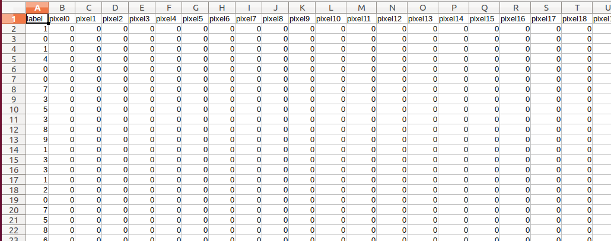
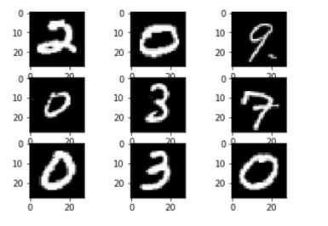
train set.csv (109.5 MB)
train label.csv (120 KB)
test set.csv (18.3 MB)
test label.csv (20 KB)

Slide 6
Extraction of Dataset
Extract 10000 samples randomly from MNIST digit database as training data, where the number of every digit (0~9) is 1000.
Extract 2000 samples as testing as well as above.
Split the testing dataset to ten files (0~9), which is used to test the accuracy of a certain digit.

Slide 7
KNN
Each sample in dataset can be seen as a vector with size of (1, 784). Supposed α and β are both Ndimensional vector, to calculate the Euclidean distance of this two vectors, a equation can be used:

Slide 8
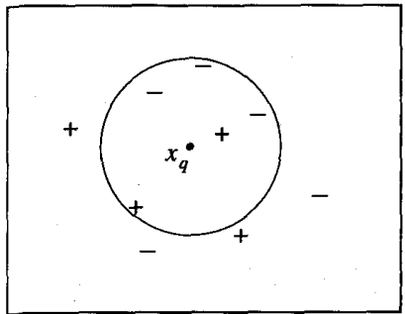
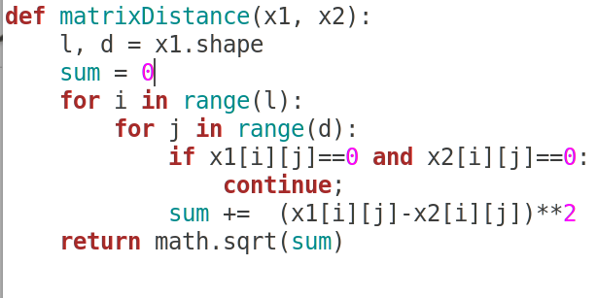
KNN

Slide 9
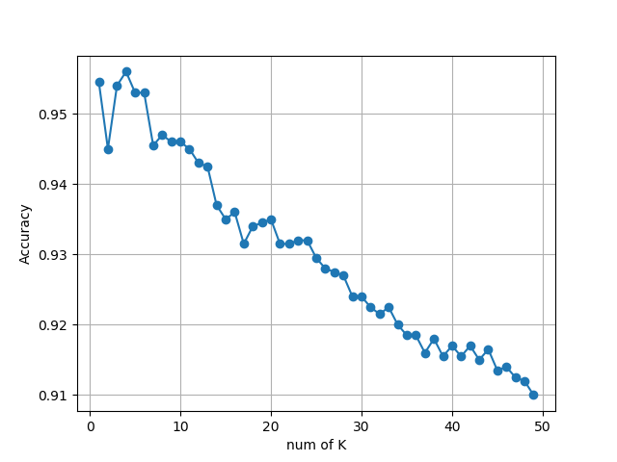
KNN
K=4, best, 95.6%

Slide 10
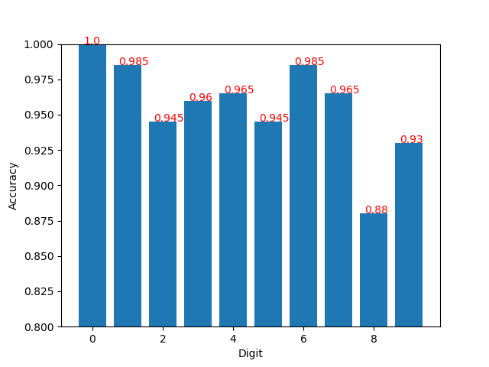
KNN

Slide 11
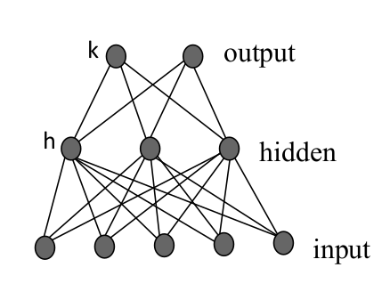
MLP
Backpropagation Algorithm
One binary output (sigmoid function)
10 to 100 units (sigmoid function)
28*28 pixel

Slide 12
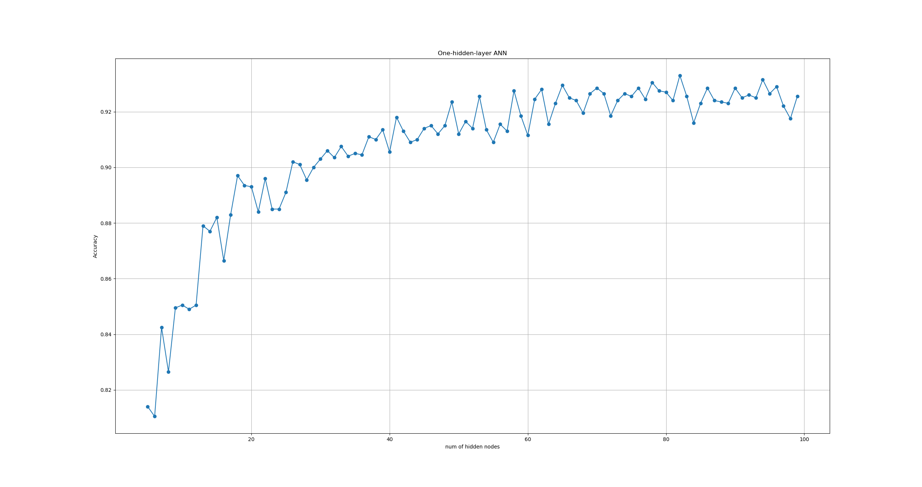
MLP
N=49

Slide 13
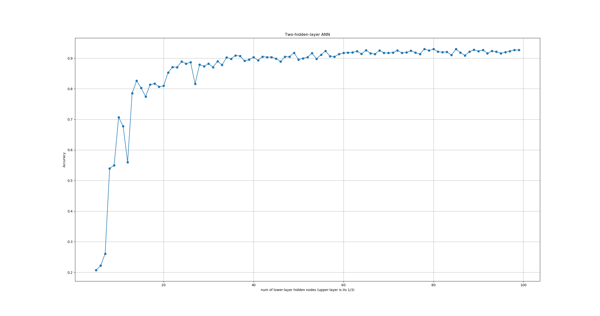
MLP

Slide 14
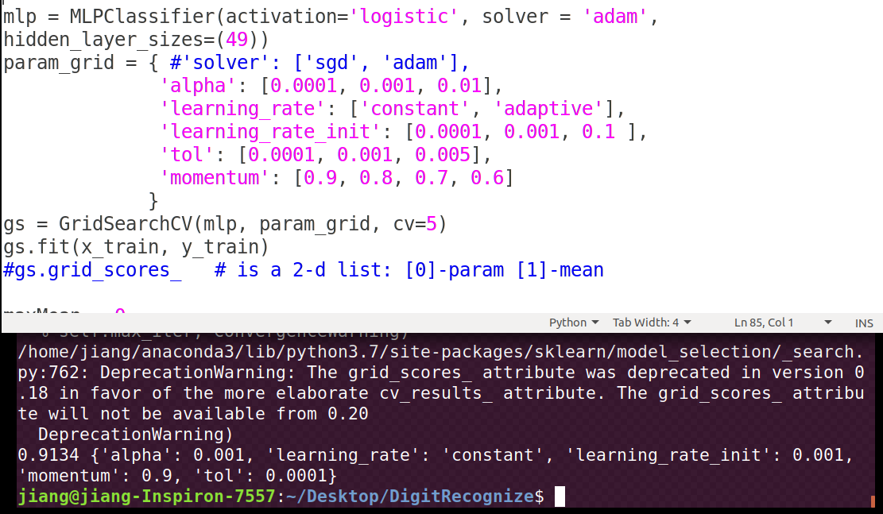
MLP
Grid Search Cross-Validation

Slide 15
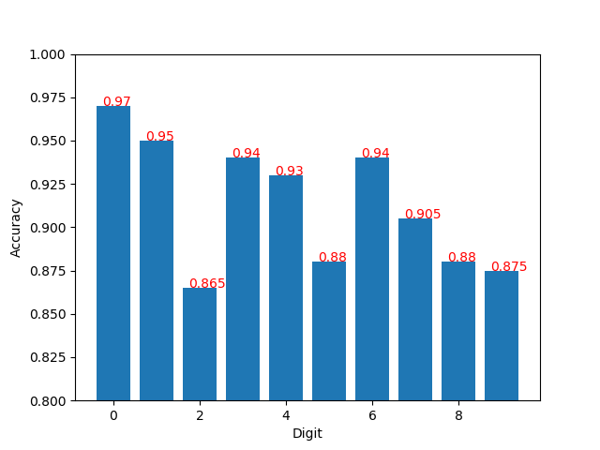
MLP
Average: 91.3%

Slide 16
SVM
For handwritten digit recognition, SVM needs to get multiple hyperplanes to get 10 categories.
Here we chose a classification strategycalled one-vs-rest (OVR). Only one digit category is treated as positive example in each classification when the rest are all negative.
For this test, we imported the SVM model from sklearn and parameters were set as following: C=100.0, kernel=poly, gamma=0.03.

Slide 17
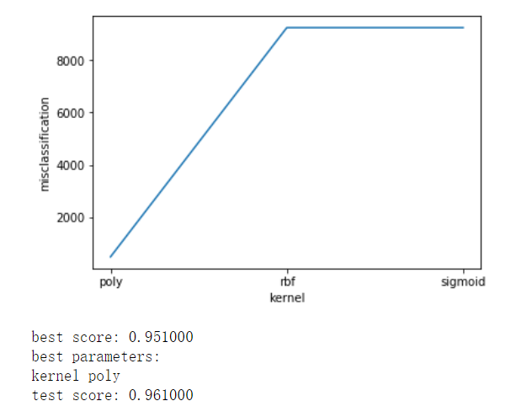
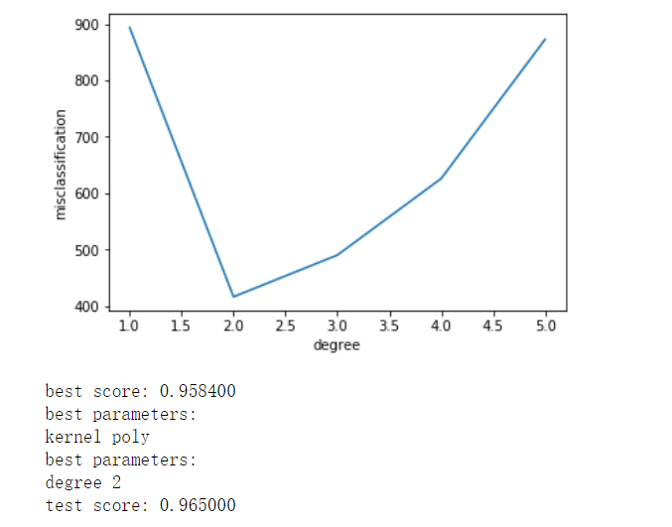
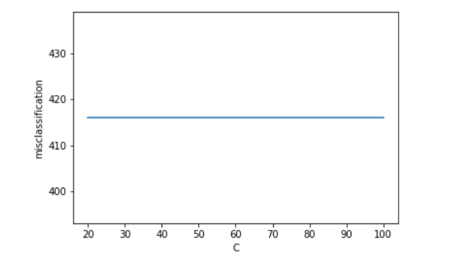
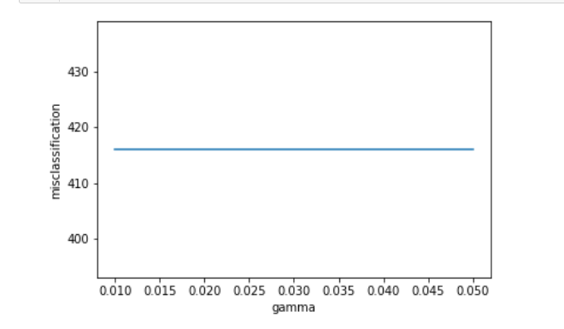

Slide 18
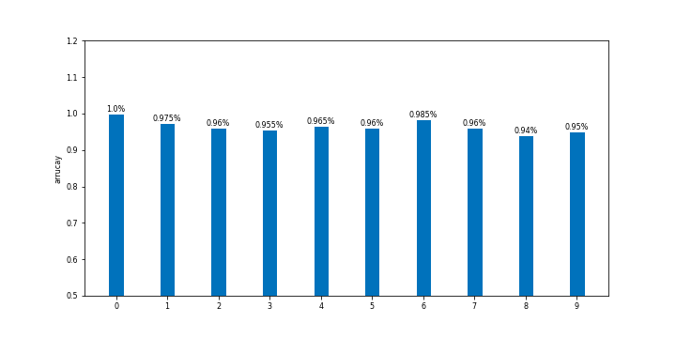
SVC(C=100.0, cache_size=200, class_weight=None, coef0=0.0,
decision_function_shape='ovr', degree=2, gamma=0.03, kernel='poly’,
max_iter=-1, probability=False, random_state=None, shrinking=True, tol=0.001, verbose=False)
Accuracy:96.5%

Slide 19
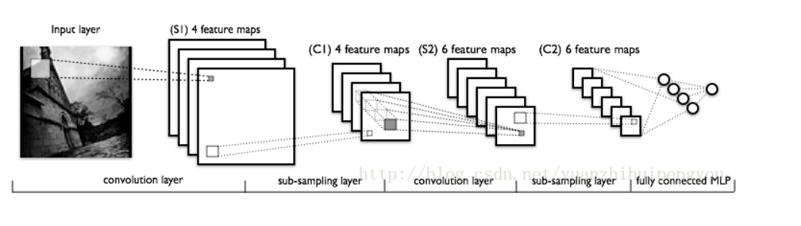
CNN
Layer | Type | filter | Neuron | Size | Kernel | Stride
F2(Out) | Fully Connected | - | 10 |  |  | -
F1 | Fully Connected | - | 1024 |  |  | -
S2 | Max Pooling | - |  | 2*2 | 2*2 | 2
C2 | Covolution | 64 |  | 7*7 | 5*5 | 1
S1 | Max Pooling | - |  | 14*14 | 2*2 | 2
C1 | Covolution | 32 |  | 28*28 | 5*5 | 1
In | Input | - |  | 28*28 |  | -

Slide 20
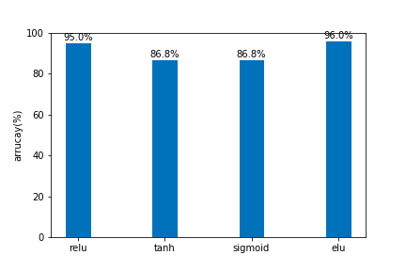
Different activation function

Slide 21
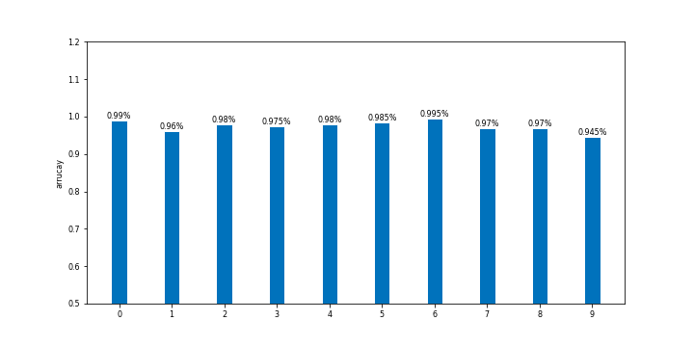
Steps:2000
Accuracy:97.5%

Slide 22
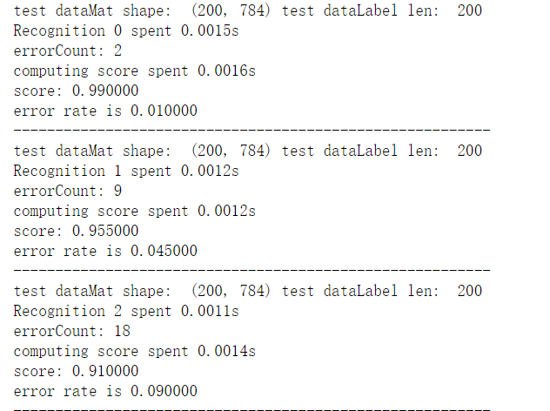
Performance comparence
Test the 10 numbers respectively

Slide 23
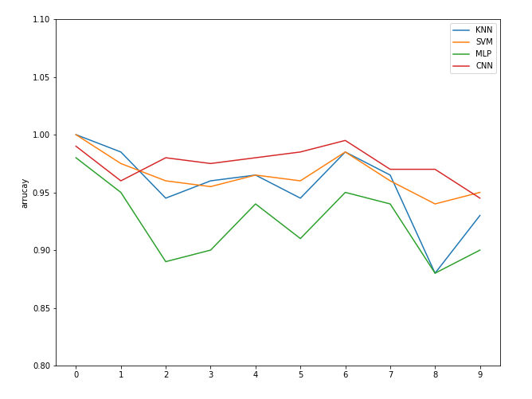
(4) KNN: 0.50s
SVM: 10.46s
CNN: 7.99s
MLP: 1.55s

Slide 24
Task Allocation
Liyan Chen：
·Data collection & preprocessing
·Design SVM model
·Improve KNN model
·Design CNN model
·Comparing performance of different models
Shangxing Jiang：
·Data preprocessing
·Design KNN model
·Design MLP model
·Result Analysis

Slide 25
Thank you !

